Slide 1


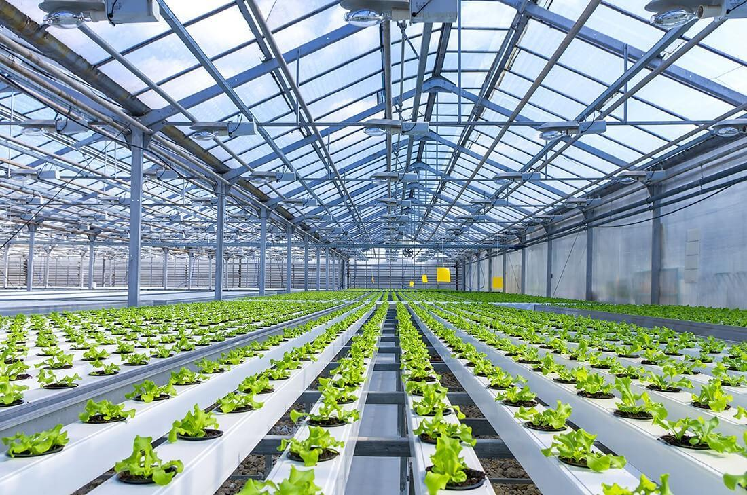
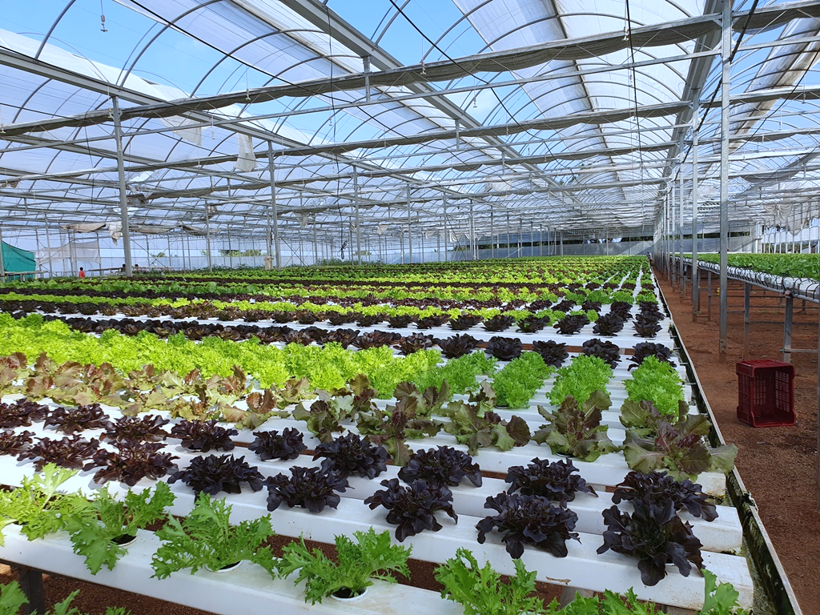
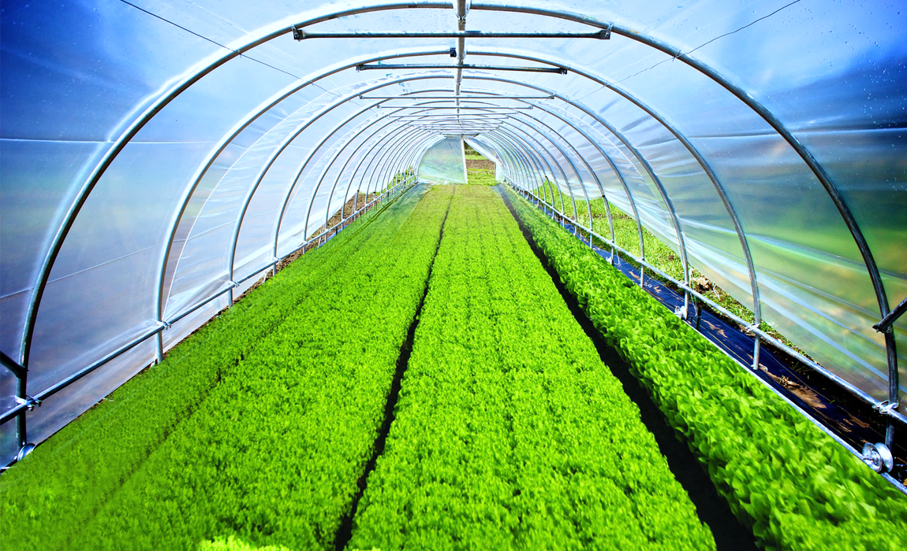

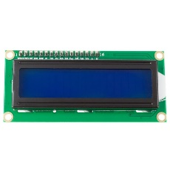

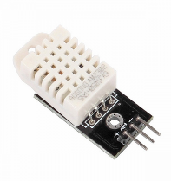
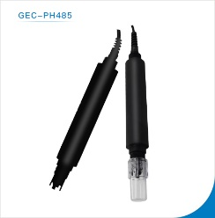
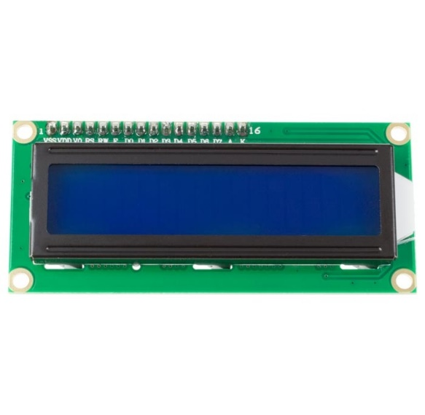
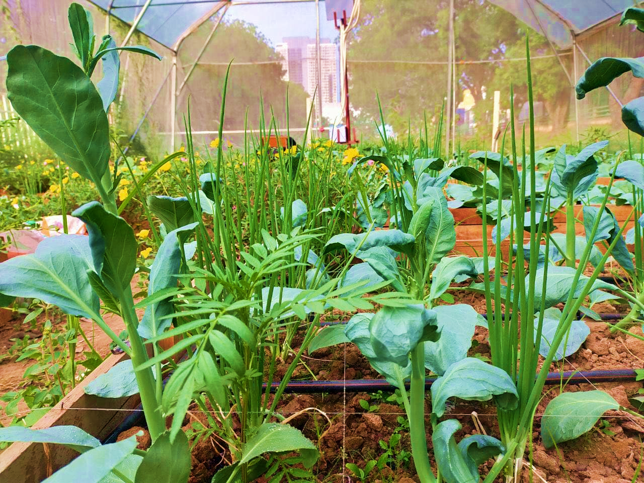

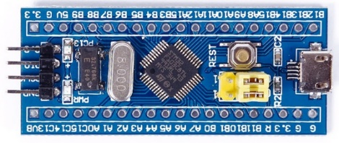

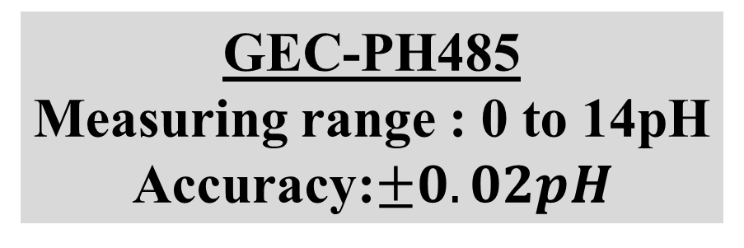
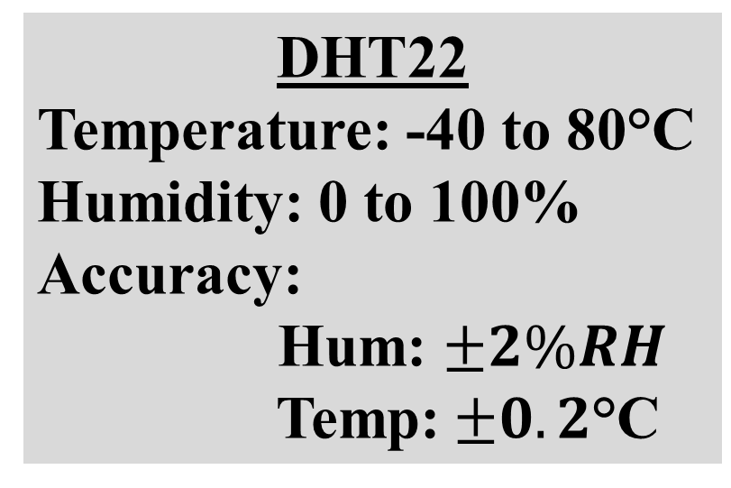
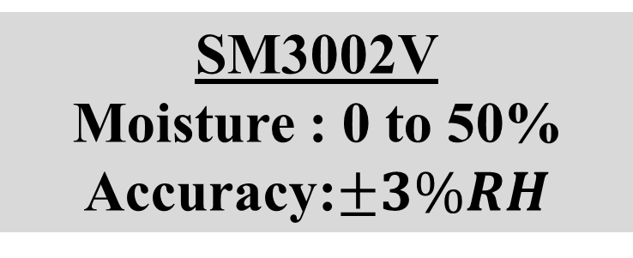
INSTITUTE OF TECHNOLOGY OF CAMBODIA
Department of Telecommunication and Network Engineering
MULTI-FUNCTION TESTER
INTRODUCTION
The main things that famer want to measure for plant in their farm are Humidity, Temperature, Moisture and Soil’s pH, but it’s so difficult to measure and control data of them. So, we create this project for support to farmer to measure that data in their farm or greenhouse. Because plants need the specific temperature, humidity and moisture to grow faster and more yield.
Hum:%
OBJECTIVE
pH : 6.7
Hum : 67%
Temp:°C
Moi : 50%
Temp : 28°C
pH
Our project is a part of Agriculture and Technology. We want to create one thing to help farmer to measure data of Temperature, Humidity, Moisture and Soil’s pH from the environment around it and it is not complex. So, We decided to invent Multi-Function Tester for solve that problem.
pH
Moi
pH : 6.7
Hum : 67 %
Moi:%
Moi : 50%
Temp : 28°C
pH
pH
Moi
ON/OFF
SENSOR
pH : 6.7
Hum : 67%
Moi : 50%
Temp : 28°C
pH
Moi
Fig1: Measuring Sensor in Greenhouse
SYSTEM ARCHITECTURE
Multi-Function Tester is an object that can collect data of temperature, humidity, moisture and soil’s pH from the environment around it. Multi-Function Tester is created by one micro-controller(STM32F103C8) with 3 sensors and a LCD on it. There are three buttons on Multi-Function Tester. One of buttons we use for turn on and turn off and another we use for allow sensor to collect data.
Multi-Function Tester also can be weather station and test-toolkit too. It’s small and we can use it with battery and power supply. So, it’s easier for famer to use it.
Fig3: Sample of Multi-Function Tester
CONCLUSION
. It also can be weather station and test-toolkit too. It’s small and we can use it with battery and power supply. So, it’s easier for famer to use it. In the future we will convert it to IoT so, famer can get data from their farm at anytime and anywhere. We will also can use it for make auto-irrigation system with Multi-Function Tester too.
LCD 1602I2C
Display 16 rows and 2 columns
DHT22
Temperature: -40 to 80°C
Humidity: 0 to 100%
Accuracy:
Hum: $±2\%RH$
Temp:$±0.2\text{°}\text{C}$
SM3002V
Moisture : 0 to 50%
Accuracy:$±3\%RH$
CONTACT
ADVISOR:
STUDENT: NHIM Chanrengsey
Email: nhimchanrengsey@gmail.com
Tel: 070562483
GitHub: https://github.com/Chanthan89/Smart-Irrigation/tree/master/Multi-Function%20Tester
GEC-PH485
Measuring range : 0 to 14pH
Accuracy:$±0.02pH$
HEL Chanthan
CHHORN Sopheaktra
TEP Sovichea
Fig2: Main Components of Multi-Function Tester

